Slide 1


VisTel
Testing Simplified

Slide 2

Problem Statement
Traditional test creation relies heavily on manual discovery of user journeys and scripted test development.
Pain Points
Manual journey discovery is slow, incomplete, and error-prone
Changes in flow breaks existing test cases, causing high maintenance costs
Different tech stacks require custom setups, slowing teams down
Gaps in coverage appear when new flows aren’t documented or tested
Scalability issues as applications grow

Slide 3

Solution
App-Agnostic, Automatic Journey Discovery
LLM-Powered Behavior Understanding & Test Generation
Automated Execution via a Stable, Deterministic Engine
Self-Updating Test Cases as Code Evolves
80–90% Reduction in Test Creation & Maintenance Effort

Slide 4
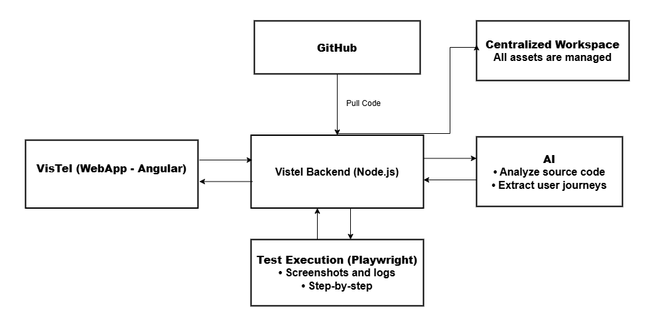
Solution Architecture

Slide 5
Demo

Slide 6
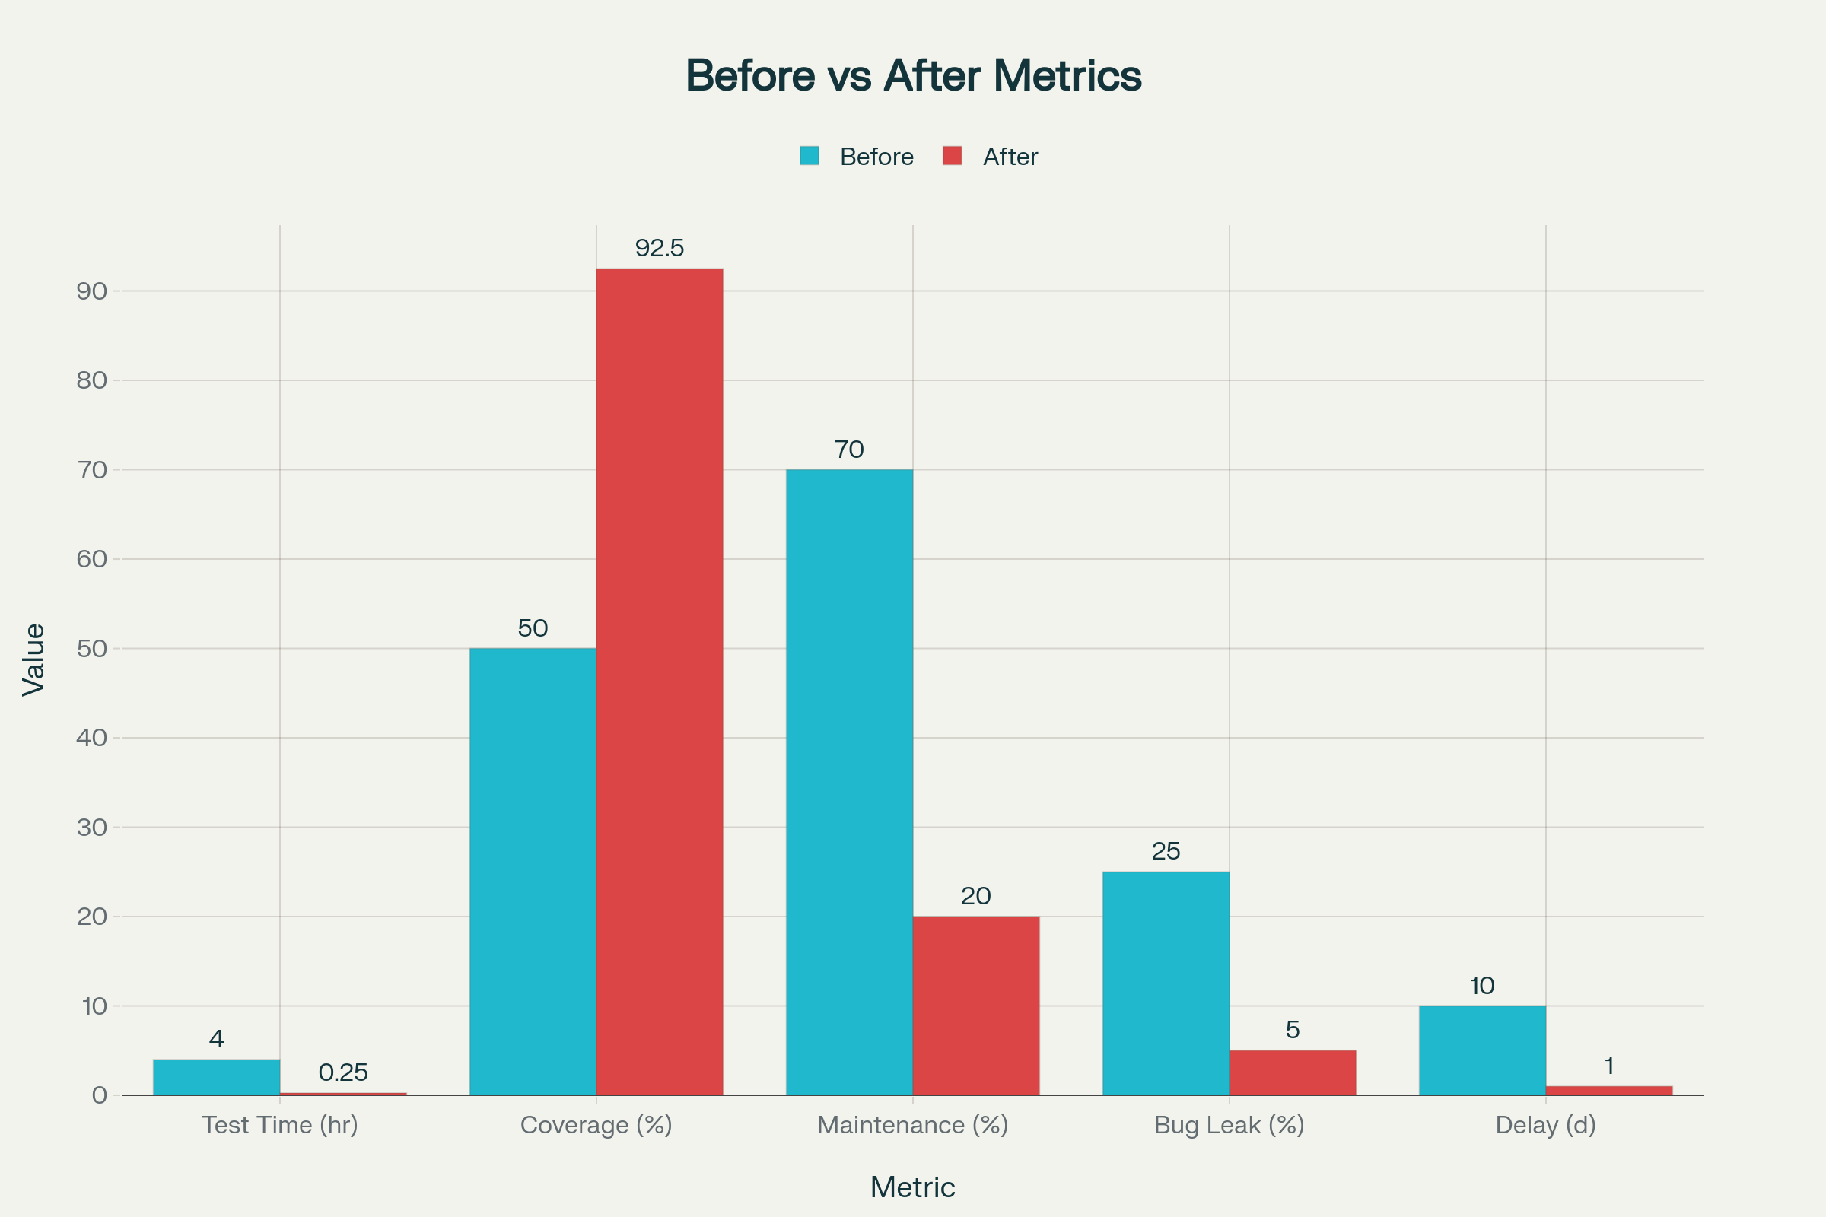
Key Impact

Slide 7
What’s Next: The Road Ahead
Automated Reporting & Notifications
Seamless CI/CD Pipeline Integration
Full Backend API Testing Integration
Smart Test Analytics Dashboard

Slide 8

Thank You​
-VisTel​

